Slide 1
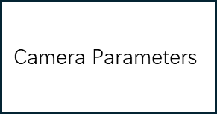
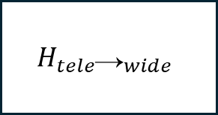



Tele Image
Subpixel Ball Detection
Center / Radius
$$H_{tele\text{→}wide}$$
Wide-Tele Registration
$$\text{3}\text{D} \text{fusion}$$
Tall Position $\text{(}\text{X}\text{, }\text{Y}\text{, }\text{Z}\text{)}$
$$\text{Camera} \text{P}\text{arameters}$$
Wide Image
$$\text{Sphere} \text{R}\text{adius} \text{R}$$

